Slide 1

Phishing Awareness Training
By Behailu Yigeramu — Cyber Security Intern @CodeAlpha
Learn how to detect, prevent, and respond to phishing threats.

Slide 2

What is Phishing?
Phishing is a cyber attack that uses deceptive emails, messages, or websites to steal sensitive data.
Common goals:
Steal login credentials
Deliver malware
Trick victims into sending money
Example: A fake “bank” email asking you to “verify your account.”

Slide 3

Phishing is a social engineering attack where attackers trick people into revealing sensitive information (like passwords, credit cards, or personal data) by pretending to be trustworthy entities.
Include:
📧 Fake emails pretending to be banks or companies
🌐 Fake websites imitating real login pages
💬 Messages with malicious links or attachments

Slide 4
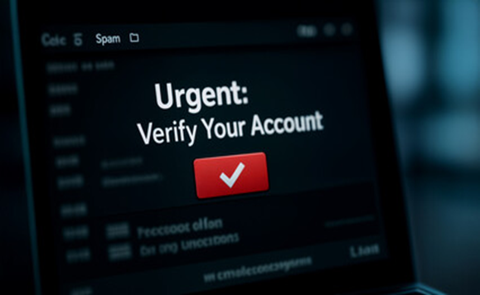
Types of Phishing Attacks
1. Email Phishing
Most common form of phishing
Attackers send fake emails pretending to be legitimate sources
Often contain malicious links or attachments 📧 Example: “Your account will be closed unless you verify now!”

Slide 5

Types of Phishing Attacks
2. Spear Phishing
Highly targeted toward specific individuals or companies
Often uses personal details to appear genuine 🎯 Example: “Hey Bob, here’s the document from HR.”

Slide 6
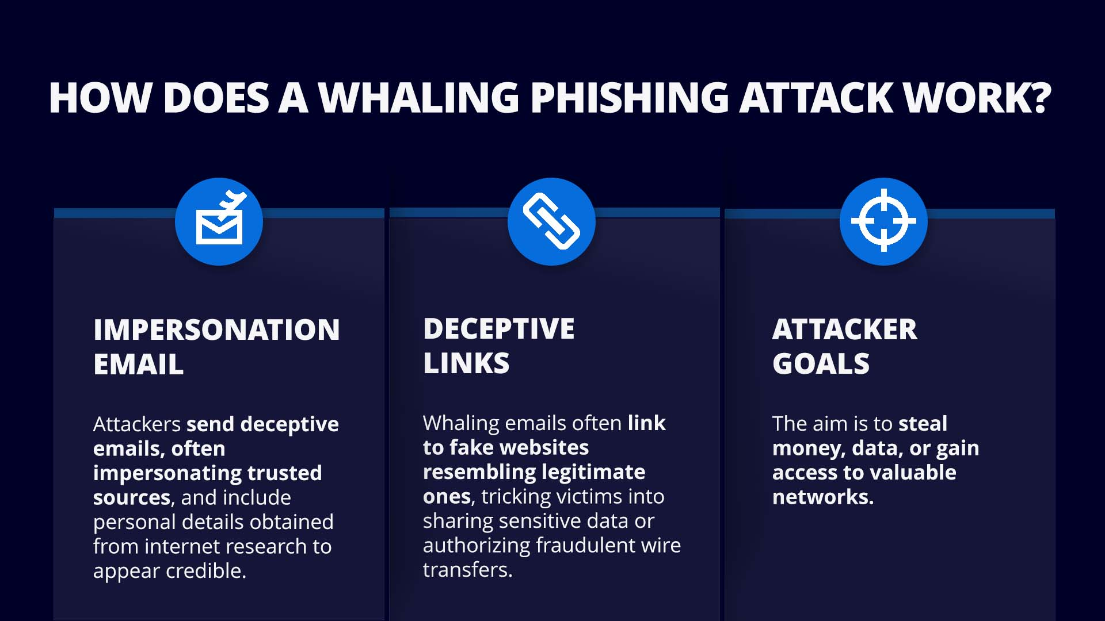
Types of Phishing Attacks
3. Whaling
Targets high-profile individuals like executives or managers
Emails often appear to come from the CEO or CFO 🐋 Example: Fake “urgent wire transfer” requests.

Slide 7
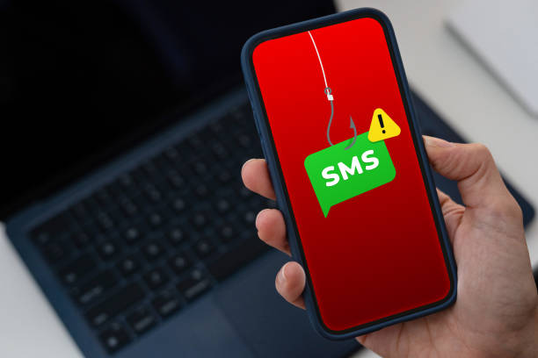
Types of Phishing Attacks
4. Smishing (SMS Phishing)
Uses text messages to lure victims
Includes short links to fake sites or malware downloads 📱 Example: “Your package is delayed — click here to track.”

Slide 8

Types of Phishing Attacks
5. Vishing (Voice Phishing)
Attackers make phone calls pretending to be from trusted institutions
Use urgency or authority to extract sensitive info 📞 Example: “This is your bank. We need your card number to verify activity.”

Slide 9
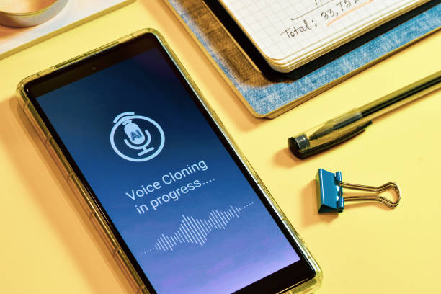
Types of Phishing Attacks
6. Clone Phishing
A real email is copied, modified, and resent with a malicious link or attachment
Victims trust it because it looks familiar 🧬 Example: “Updated version of your invoice.”

Slide 10
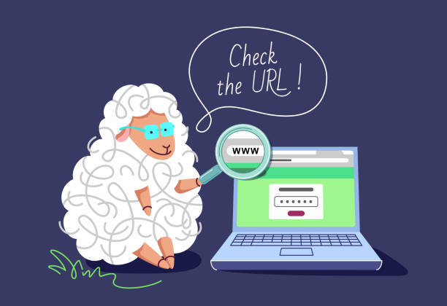
Types of Phishing Attacks
7. Pharming
Redirects users from legitimate websites to fake look-alike domains
Often done by exploiting DNS or browser vulnerabilities 🌐 Example: Typing bank.com but ending up on bannk.com.

Slide 11

Types of Phishing Attacks
8. Angler Phishing
Happens on social media platforms
Fake support accounts or comment links trick users 💬 Example: “We noticed an issue with your account. Please verify here.”

Slide 12
How to Recognize a Phishing Email
🚩 Red Flags:
Suspicious sender address
Urgent language (“Act now!”, “Account locked!”)
Grammar or spelling errors
Unusual links or attachments
Mismatched URLs (hover to preview)
Fake login pages
Urgent or threatening ton
Fake URLs (hover to check links)
📧 Example: From: it-support@secure-company-login.com Subject: “Reset your password now!”

Slide 13
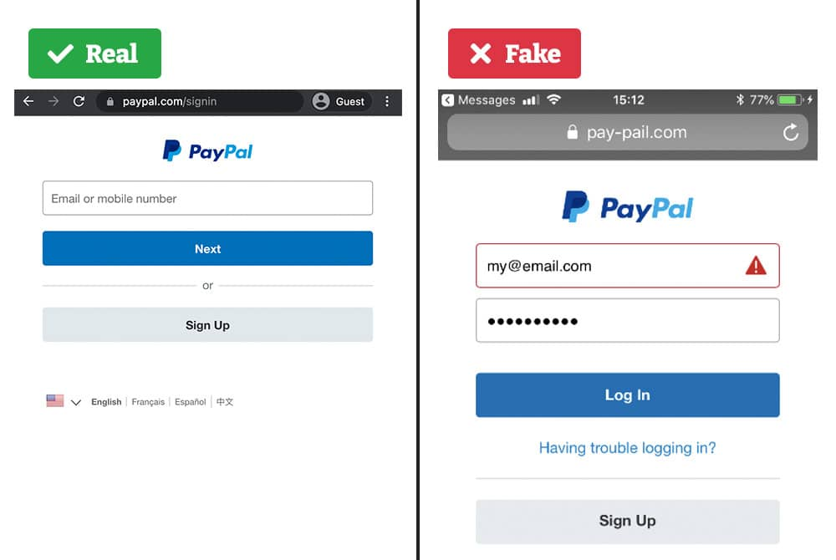
Fake Websites
❌ Fake pages often: ✅ Always:
Mimic real login forms -> Check domain spelling
Mimic real login forms -> Verify SSL (🔒icon)
Use similar domain names (e.g., faceb00k.com) -> Bookmark official sites
Lack HTTPS or use invalid certificates

Slide 14
Social Engineering Tactics
Attackers exploit human psychology, not just technology.
Common tricks:
Authority: Pretending to be a boss or IT staff
Urgency: “Act now or lose access!”
Fear: “Your account is hacked!”
Greed: “You’ve won a free phone!”
Curiosity: “See who viewed your profile!”
Impersonation – fake identities or domains
Pretexting – creating a fake scenario to trick victims.

Slide 15
Best Practices & Prevention Tips
✅ Do
Check sender address and URL carefully
Use 2FA (Two-Factor Authentication)
Keep browsers and OS updated
Verify suspicious requests by contacting the company directly
Report phishing attempts
❌ Don’t
Click on links from unknown senders
Download unexpected attachments
Enter credentials on suspicious pages

Slide 16

Real-World Examples
Google Docs Phish (2017) Fake document links compromised thousands of accounts.
Google Docs users hit with sophisticated phishing attack in their inboxes.

Slide 17
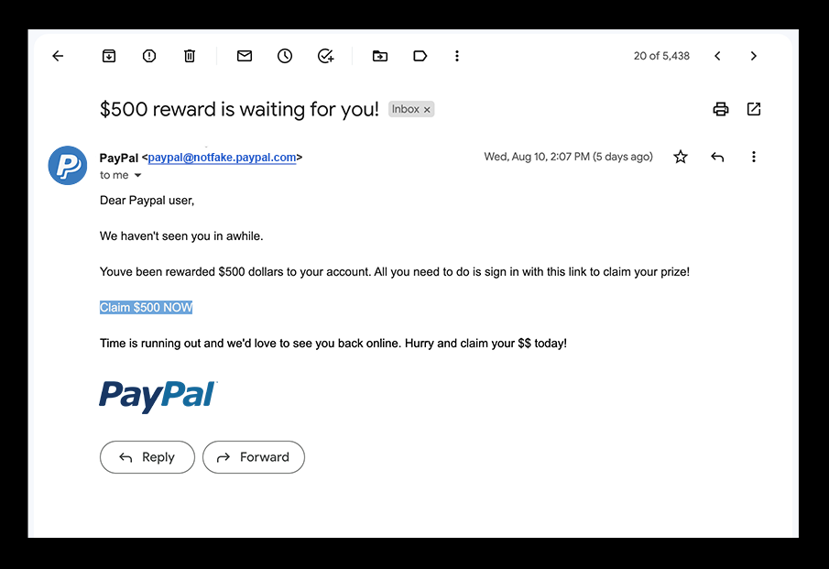
Real-World Examples
PayPal Scams
Users got fake payment requests.
PayPal phishing scam email example showing urgent request to claim money.

Slide 18
Quiz — Test Your Knowledge
1. What is phishing? A. A type of social engineering attack B. A virus infection C. A firewall configuration D. A password manager
2. Which of the following is the most common type of phishing attack? A. Spear Phishing B. Clone Phishing C. Email Phishing D. Vishing
3. Spear phishing targets: A. A large group of random users B. Specific individuals or organizations C. Only government agencies D. Only banks
4. What is “vishing”? A. Phishing through voice calls B. Phishing through video messages C. Phishing through emails D. Phishing via social media
5. Smishing refers to phishing attacks conducted via: A. Email B. SMS or text messages C. Voice calls D. Web forms

Slide 19
Quiz — Test Your Knowledge
6. What is “clone phishing”? A. A fake website copied from a legitimate one B. A duplicated email that looks identical to a real one C. A phishing attack using cloned mobile apps D. A phishing link inside social media comments
7. Whaling attacks are aimed at: A. Regular employees B. Students C. High-profile executives D. IT administrators only
8. Which of the following is a sign of a phishing email? A. Official company logo B. Grammatical errors and urgent tone C. Personalized greeting D. Secure HTTPS link
9. Angler phishing occurs mainly on: A. Banking websites B. Social media platforms C. Online shopping sites D. Corporate intranets
10. The best defense against phishing is: A. Ignoring unknown messages B. Regular software updates C. Security awareness training D. Using strong passwords

Slide 20
Summary
Think before you click
Trust, but verify
Report phishing attempts immediately
“Humans are the weakest link — and the strongest defense.”

Slide 21
Thank You
Phishing Awareness Training By Behailu Yigeramu — CodeAlpha Cyber Security Intern
📧 behailuyigeramu@gmail.com
🔗 linkedin.com/in/behailu-yigeramu-405875316/

